Slide 2

Notes:
This isn't me.

Slide 3


Notes:
And this isn't me.

Slide 4

Notes:
And this...
well, this one is me.
Long story.

Slide 5



Glen R. Goodwin
@areinet
arei.net
github.com/arei
Notes:
Here I am.
And these are my places…
and I work for this company

Slide 6

Notes:
The Awesome Engineering Company.
Which makes libraries and enterprise applications for scaling up with nodejs.
I'll hit you with the sales pitch in a few minutes.
But for today I'm here to talk to you about

Slide 7
Why are you “Awaiting”
to use
Async!
Notes:
Why Are You "Awaiting" to use Async!
(I promise that will be the last pun of the night unless Sal gets crazy again and grabs the mic)
BUT!

Slide 8

The HISTORY of JAVASCRIPT
Notes:
In order to talk to you about Async/Await
we first need to revisit the history of JavaScript.
And I'm sure many of you have heard this before,
so I will try to be quick.

Slide 9

Notes:
1993 we get the first graphical browser NCSA Mosaic

Slide 10

Notes:
1994 we get the first commercial browser, Mosaic Netscape 0.9

Slide 11
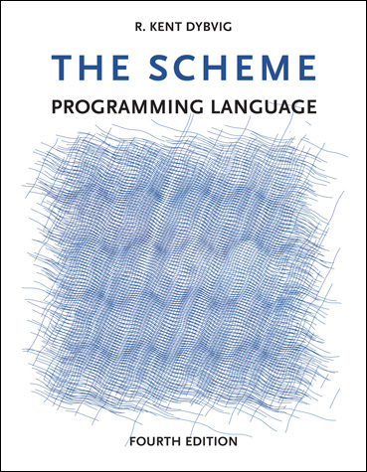
Notes:
1995 Netscape realizes that HTML needs a "glue language".
They hire Brendan Eich to implement the Scheme Programming Language for their Browser.
(Yes, the initial plan was to have Scheme as the scripting language of the browser.)
But just as Eich was coming on board,

Slide 12

Notes:
Netscape signed an agreement with Sun Microsystems,
Who invented and owned the Java Programming language
to provide Java in browsers.
And thus the dark age of web applets
was born.

Slide 13


+
=
Notes:
In May of 1995 Eich writes JavaScript in 10 days.
It borrows Java's syntax.
But it also borrows some very interesting features from Scheme.

Slide 14
x = 123
x
f
f = function() {
…
}
y
y = “hello”
Notes:
In particular, Scheme stores functions and variables
in the same reference lookup table.
Meaning a variable can be a reference to a function.
this means functions can be passed as arguments
to other functions
and called within those functions.

Slide 15
on(“click”,function(){
… do something …
});
Notes:
Thus the JavaScript Callback was born.
And its used pretty much right away in the browser
for event handling and the like.
And in 1998, we get our first AJAX/XMLHttp efforts.
And thus begins the slightly less dark age known as "Callback Hell"

Slide 16

doSomething(function(){
});
CALLBACK HELL
Notes:
Wherein one function
calls a function with a callback
which in turn calls a function with a callback

Slide 17
doSomething(function(){
andThis(function(){
andDontForgetThis(function(){
andTomWantedThis(function(){
gottaMakeItSecure(function(){
butMarketingNeedsItThisWay(function(){
turnItGreen(function(){
console.log(“Umm….”);
});
});
});
});
});
});
});
CALLBACK HELL
Notes:
which in turn calls a function with a callback
which in turn calls a function with a callback
which in turn calls a function with a callback
which in turn calls a function with a callback
which in turn calls a function with a callback
A lot of people find this frustrating
And a bunch of these people create the notion of a Promise.

Slide 18

A Promise represents an operation to be completed in the future.
Notes:
A Promise
(sometimes called a Future or Deferred in other languages)
represents an operation to be completed in the future.
Promises are callbacks taken up a notch.
But underneath a promise is just a bunch of callback magic.

Slide 19

Notes:
2012ish We see the first Promise specifications
Promises/A (and B and C and D and eventually A+)

Slide 20
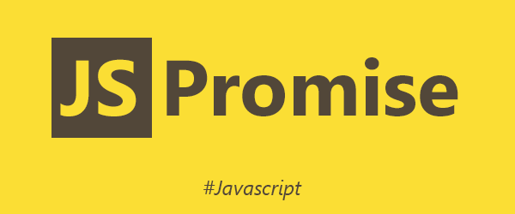
Notes:
June 2015 Promise Formally Added to JavaScript.
And everyone can start using them!
Hooray!
And thus begins the medium gray age called Promise Purgatory(tm).

Slide 21

doSomething()
.then(function(){
});
PROMISE PURGATORY
™
Notes:
Wherein one promise
chains another promise

Slide 22
doSomething()
.then(function(){
})
.then(function(){
})
.then(function(){
})
.then(function(){
})
.then(function(){
})
.then(function(){
})
.then(function(){
});
PROMISE PURGATORY
™
Notes:
then another promise
then another promise
then another promise
then another promise
then another promise
then another promise
But the people who came up with Promises
knew that it wasn't really about promises.
Promises were a stepping stone.
To something better.

Slide 23
async/await
Notes:
Async/await
But first…

Slide 24

Notes:
A KITTEN!
This is our brand new kitten Zephyr.
So cute!
And now that I've pulled you in with a kitten, a commercial!

Slide 25
commercial
Notes:
So in the early part of last year
I was working for a company building a
cyber security system,
much of it written in nodejs,
and handling massive amounts of data.
Yet I felt like other people
didnt really understand the scale
nodejs could be capable of.
I kept telling people about my work
and they kept looking at me like I was crazy
for wanting to write these things in nodejs.
Most people see nodejs as a very niche thing.
For your simple API level, sure.
Maybe a command line utility here or there.
But handle massive scale?
Not with a single threaded interpreted language you wont!
So in july of last year
I gave my notice
packed up my big corner office
and started an entirely new adventure.
I started
The Awesome Engineering Company.

Slide 26
Notes:
I did this because
I wanted to explore nodejs at scale.
I did this because
I wanted to find answers to what is possible.
and I did this because
I wanted to build these answers
and share them with the world.
In the coming months
I will be sharing some of what I have been doing and building.
And I hope that all of you will help me out.
Take my stuff for a test drive.
give me lots of feedback on what you find.
file some bugs you come across.
and share with me some of your needs that nodejs at scale can address.

Slide 27
async/await
Notes:
Now back to
Async/Await

Slide 28
async function HelloWorld() {
console.log("hello");
await sleep(1000);
console.log("world");
};
Notes:
The purpose of Async/Await is to make javascript...
wait...
for a promise to resolve or reject.
That's it.
Nothing complicated.
But its so much more than that!
ONE

Slide 29
1
async function HelloWorld() {
console.log("hello");
await sleep(1000);
console.log("world");
};
Notes:
using await means no more then() methods.
I've been using async/await heavily for probably 18 months now and I think I've written maybe 3 then() methods in that time.
TWO

Slide 30
2
async function HelloWorld() {
console.log("hello");
await sleep(1000);
console.log("world");
};
Notes:
TWO
values returned from the promise, are just returned from the await.
THREE

Slide 31
3
async function HelloWorld() {
console.log("hello");
await sleep(1000);
console.log("world");
};
Notes:
when a promise rejects, it just becomes a thrown error!
That you can catch!
With a try/catch block.
FOUR

Slide 32
4
async function HelloWorld() {
console.log("hello");
await sleep(1000);
console.log("world");
};
Notes:
async/await is fundamentally cleaner to read.
FIVE

Slide 33

Notes:
another picture of my kitten!
How can you say no to him?
So, now that we know Async/Await is awesome,
Let take a look at how we use it.

Slide 34
BASIC EXAMPLE
Notes:
Here is a basic example:

Slide 35
BASIC EXAMPLE
Sleep =>
wait for n milliseconds
return
Notes:
Say we have a function, sleep,
which returns a promise.
that resolves after n milliseconds.

Slide 36
BASIC EXAMPLE
Sleep =>
wait for n milliseconds
return
HelloWorld =>
print “hello”
sleep 1000ms
print “world”
Notes:
Now, say we want to print out "hello",
wait 1000ms,
and then print out "world".

Slide 37
BASIC EXAMPLE
CALLBACK
function sleep(ms,done) {
setTimeout(()=>{
done();
}, ms);
};
function HelloWorld() {
console.log("hello");
sleep(1000,()=>{
console.log("world");
});
};
HelloWorld();
Notes:
With callbacks, our code would look like this:
Sleep takes two arguments,
the number of milliseconds to sleep
and the callback function to execute when done.
Our HelloWorld function,
writes out "hello",
calls sleep with 1000 and the function to run when done
which after 1000ms executes.
and writes out "world".

Slide 38
BASIC EXAMPLE
CALLBACK
PROMISE
function sleep(ms,done) {
setTimeout(()=>{
done();
}, ms);
};
function HelloWorld() {
console.log("hello");
sleep(1000,()=>{
console.log("world");
});
};
HelloWorld();
function sleep(ms) {
return new Promise(
(resolve,reject)=>{
setTimeout(()=>{
resolve();
}, ms);
});
};
function HelloWorld() {
console.log("hello");
sleep(1000).then(()=>{
console.log("world");
});
};
HelloWorld();
Notes:
With promises, our code would look like this:
Sleep takes one argument,
the number of milliseconds to sleep,
and returns a promise.
The promise will resolve, after the given number of milliseconds has passed.
Our HelloWorld function,
writes out "hello",
calls sleep with 1000
and tells the returned promise what to execute next.
which after 1000ms executes.
and writes out "world".

Slide 39
BASIC EXAMPLE
CALLBACK
PROMISE
async/await
function sleep(ms,done) {
setTimeout(()=>{
done();
}, ms);
};
function HelloWorld() {
console.log("hello");
sleep(1000,()=>{
console.log("world");
});
};
HelloWorld();
function sleep(ms) {
return new Promise(
(resolve,reject)=>{
setTimeout(()=>{
resolve();
}, ms);
});
};
function HelloWorld() {
console.log("hello");
sleep(1000).then(()=>{
console.log("world");
});
};
HelloWorld();
function sleep(ms) {
return new Promise(
(resolve,reject)=>{
setTimeout(()=>{
resolve();
}, ms);
});
};
async function HelloWorld() {
console.log("hello");
await sleep(1000);
console.log("world");
};
HelloWorld();
Notes:
With async/await, our code would look like this:
Sleep is the same as from the promise example.
It takes one argument,
the number of milliseconds to sleep,
and returns a promise.
The promise will resolve, after the given number of milliseconds has passed.
Our HelloWorld function,
writes out "hello",
awaits a call to sleep with 1000
sleep resolves,
the await ends,
and it writes out "world".
In our basic await example, you might have noticed a new keyword before
our HelloWorld function definition: "async".

Slide 40
The async Keyword
async function HelloWorld() {
console.log("hello");
await sleep(1000);
console.log("world");
};
Notes:
In order to use "await" we must first tell JavaScript to expect it.
this is done at the function level
by specifying that the function is an async function.
This creates a slightly different type of function than a function definition without the async keyword.
You can see this with a quick test in nodejs.

Slide 41
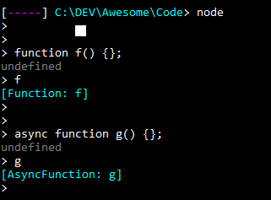
The async Keyword
async function HelloWorld() {
console.log("hello");
await sleep(1000);
console.log("world");
};
Notes:
an async function will execute like anormal function
until it hits an await statement.
At that point the async function execution will pause
until the awaited promise resolves
and then the async function execution will continue
This pause doesn't block the main javascript thread at all, so
tasks waiting in the execution stack will continue to run while paused.
once we have an async function, we can use await.

Slide 42
The await Keyword
async function HelloWorld() {
console.log("hello");
await sleep(1000);
console.log("world");
};
Notes:
The await keyword is used to tell an async function
that it should wait for the expression that follows to resolve.

Slide 43
The await Keyword
await square(4);
await 123;
await “concat” + “this” + “string”;
Notes:
await must be followed by an expression
as in "await sleep(1000)" or "await some value".

Slide 44
The await Keyword
If this returns a promise, wait for the promise to resolve or reject.
await square(4);
await 123;
await “concat” + “this” + “string”;
Notes:
If the evaluated expression results in a promise,
await will pause execution
until the promise resolves or rejects

Slide 45
The await Keyword
If this or these return anything else, wrap it in a Promise.resolve() and wait for it to resolve.
await square(4);
await 123;
await “concat” + “this” + “string”;
Notes:
If the evaluated expression does not result in a promise,
a value for example,
await will wrap the value in an immediately resolving promise.
So saying this is functionally the same as saying this.

Slide 46
The await Keyword
assert.equal(await square(4),16);
let x = await 123;
return await “concat” + “this” + “string”;
Notes:
Await is an expression in and of itself
And thus can be used anywhere an expression is
Including assignments
Or returns
Or as arguments.

